Slide 1

MLOps minutes
Data Splitting
Guillaume Chervet

Slide 2
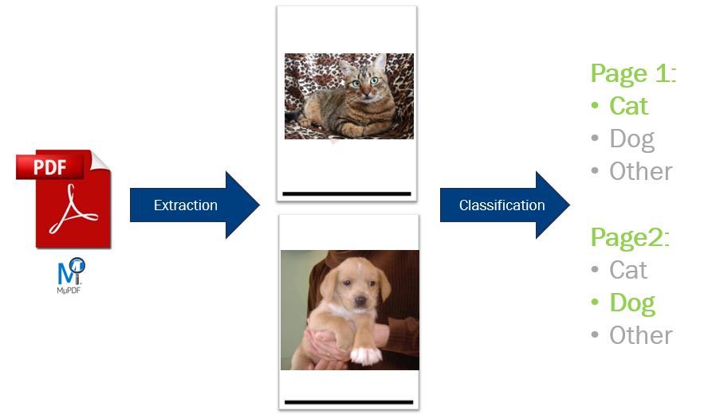
Le MLOps est une aventure Humaine – Guillaume Chervet

Slide 3
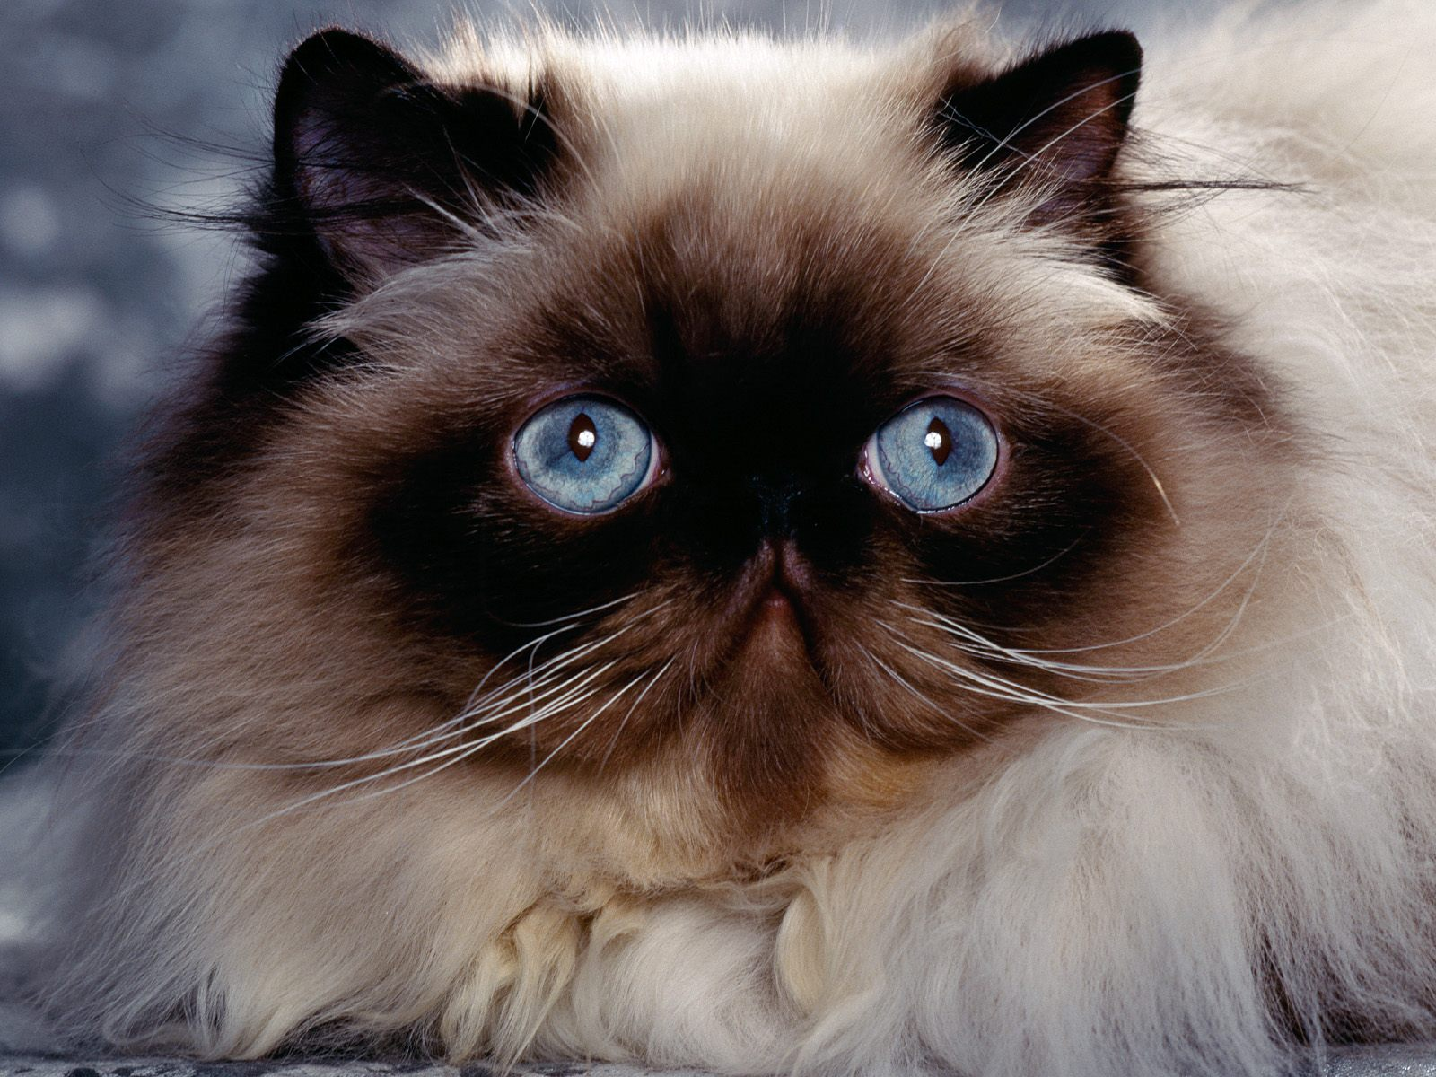
Extraction
10 000 pdfs
> 30 000 images
Le MLOps est une aventure Humaine – Guillaume Chervet

Slide 4
Dataset of 10 000 pdfs
Train a model
13 000
images train
4 000 images validation
3 000 images
test
Le MLOps est une aventure Humaine – Guillaume Chervet
Notes:
Before starting the demo. Imagine that we have 20,000 files available. We will use 17,000 files for training the model. Then we will keep 3000 files aside for validation, to test our model on data it has never seen. This validation DATASET will also be used to test our production environments.

Slide 5
Dataset of 20 000 pdfs
Train a model
13 000
images train
4 000 images validation
3 000 images
test
1 000 PDFs integration
Le MLOps est une aventure Humaine – Guillaume Chervet

Slide 6

train | Cats: cat1.png, cat2.png, etc. Dogs: dog1.png, dog2.png, etc. Others: other1.png, other2.png, etc.
validation | Cats: cat3.png, cat4.png, etc. Dogs: dog3.png, dog4.png, etc. Others: other3.png, other4.png, etc.
test | Cats: cat5.png, cat6.png, etc. Dogs: dog5.png, dog6.png, etc. Others: other5.png, other6.png, etc.
integration | file1.pdf file2.pdf, etc. file1: image1.png, image2.png, images3.png file2: image1.png, image2.png
Le MLOps est une aventure Humaine – Guillaume Chervet

Slide 7
Dataset of 10 000 pdfs
1% Cats
20% Dogs
79% Others
Le MLOps est une aventure Humaine – Guillaume Chervet
Notes:
Before starting the demo. Imagine that we have 20,000 files available. We will use 17,000 files for training the model. Then we will keep 3000 files aside for validation, to test our model on data it has never seen. This validation DATASET will also be used to test our production environments.

Slide 8
random.seed(11) pdfs = [ p for p in Path(input_pdfs_directory).iterdir() if p.is_file() and p.suffix == ".pdf" ]
random.shuffle(pdfs)
Le MLOps est une aventure Humaine – Guillaume Chervet

Slide 9
How many data do I need ?
Le MLOps est une aventure Humaine – Guillaume Chervet
Notes:
Before starting the demo. Imagine that we have 20,000 files available. We will use 17,000 files for training the model. Then we will keep 3000 files aside for validation, to test our model on data it has never seen. This validation DATASET will also be used to test our production environments.

Slide 10
Conclusion
Le MLOps est une aventure Humaine – Guillaume Chervet

